Slide 1
Developers Assignment for Analyzing Pull Requests
Manoel Limeira de Lima Júnior limeira@ufac.br
Daricélio Soares – UFAC/Brazil
Alexandre Plastino – UFF/Brazil
Leonardo Murta – UFF/Brazil
Notes:
‘

Slide 2
Agenda
Introduction
Materials and methods
Methodology
Projects
Attributes
Results and discussion
Accuracies of the classification algorithms
Developer’s ranking
Conclusions
Notes:
This presentation is organized into four sections.
Introduction, I am going to discuss what motivated us to work on this paper.
In the section of materials and methods, I will present the methodology, projects, and attributes used in the experiments.
In the results and discussion section, I will present the accuracies of the algorithms and analysis of developer’s ranking for analyzing pull requests.
Finally, the conclusions and recommendations for future work.

Slide 3
Agenda
Introduction
Materials and methods
Methodology
Projects
Attributes
Results and discussion
Accuracies of the classification algorithms
Developer’s ranking
Conclusions
Notes:
Now, I am going to discuss the introduction.

Slide 4
Pull Request Model
Collaborator
Start Process
Local Repository
Create Fork
Create Clone
Submit Commits
Push
Commits
Submit Pull Request
Fork Repository
Core Team
Main Repository
Analyze Pull Request
Merged
Closed
Notes:
Aiming at facilitating the collaborative software development, many open source projects have adopted the pull request model.
This workflow allows the sharing of the main repository in which any developers has reading permission.
The collaborator can create a copy of the main repository on the server (fork), which happens to be writable.
The collaborator copies this fork to his workstation (clone), makes changes locally (commit) and incorporates in the fork (push).
However, for the set of changes to take effect in the main repository, the collaborator needs to send a pull request, so he does not have writing permission on it.
Therefore, members of the core team, who have writing permission to the main repository are responsible for making the code analysis and deciding whether the pull request will be accepted or rejected in the main repository.

Slide 5
Motivation
GitHub
Fixing bugs
Developing new features
Pull request
Classifications algorithms
Developer’s ranking
Who should analyze a new pull request?
Notes:
The growing usage of code hosting sites, such as GitHub, have provided new opportunities for collaboration among developers.
In these cooperative environments, any developers can participate in a project by fixing bugs or developing new features.
In active community projects a great number of pull requests is generated per month.
A pull request contains the necessary source code to solve a change request and it needs to be analyzed by a member of the core team.
Thus, a problem that gains importance in the model is to predict who should analyze a new pull request. To make this prediction we propose the use of classification algorithms and the suggestion of the most suitable developers’ ranking to analyze them.

Slide 6
Agenda
Introduction
Materials and methods
Methodology
Projects
Attributes
Results and discussion
Accuracies of the classification algorithms
Developer’s ranking
Conclusions
Notes:
Now, I am going to discuss about material and methods.

Slide 7

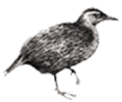

Methodology
J48
Naive Bayes (NB)
Random Forest (RF)
Support Vector Machine (SVM)
k-Nearest Neighbors (k-NN)
Select Projects and Attributes
k-fold Cross Validation
Friedman and Nemenyi Statistics
GHTorrent
Notes:
The attributes and projects used in the process of developer’s assignment were extracted from the GitHub repositories by the GHTorrent tool.
We used five classifiers from different paradigms of WEKA’s tool: The naive Bayes classifier, the decision tree with J48 implementation, the ensemble Random Forest, Support Vector Machine, and K-Nearest Neighbors. These algorithms were chosen because represent different paradigms of machine learning with good performance.
To evaluate the classifiers we used the k-fold cross validation method, with k = 10.
Finally, to confirm the statistical significance of the experiments, we used the tests of Friedman and Nemenyi.
Additionally, a ranking with the three most appropriate developers was suggested.

Slide 8
Projects
Filters used in the selection of projects and pull requests
Projects with more than 2,000 pull requests
Projects with information about who analyzed the pull requests
Projects with more than five developers
Projects where the majority class (MC) is not predominant (below 50%)
Pull requests not analyzed by the same developer that sent it
21 projects selected
Notes:
We are interested in making developer’s assignment on projects that receive many pull requests and that have a core team to distribute the analysis.
Therefore, we have established five filters to select projects and pull requests:
Projects that received more than two thousand pull requests;
Projects that had information about who analyzed the pull requests;
Projects with more than five developers in the core team;
Projects in which there is no single developer responsible for over half of the pull request analysis, this is the majority class is not predominant.
Pull requests analyzed by the same developer that sent it.
This way, 21 database projects have been left to be tried out.

Slide 9
Characteristics of the selected projects
Project | Core Team | Pull Request | Average Time (days)
 |  |  | Core |  | External
 |  |  | Closed | Merged | Closed | Merged
rosdistro | 8 | 2,667 | 0.10 | 0.019 | 0.79 | 0.21
Baystation12 | 14 | 2,364 | 1.71 | 0.45 | 2.93 | 0.61
commcare-hq | 11 | 2,468 | 1.26 | 0.78 | 1.54 | 1.18
scala | 10 | 2,468 | 5.14 | 2.73 | 9.40 | 5.33
... | ... | ... | ... | ... | ... | ...
gaia | 107 | 5,254 | 14.07 | 2.85 | 26.34 | 5.47
rails | 29 | 7,403 | 22.55 | 3.53 | 46.78 | 9.02
metasploit | 22 | 2,575 | 13.48 | 4.49 | 32.73 | 7.40
xbmc | 41 | 2,006 | 55.46 | 9.53 | 72.59 | 13.89
Average | 21.90 | 2,401 | 15.69 | 4.14 | 31.51 | 7.62
Notes:
After the application of filters, we can observe in these projects that the pull requests sent by the core team were analyzed faster than the ones sent by external developers.
On average, the pull request analysis took about four to sixteen days when the core team sent it. On the other hand, it took about seven to thirty-two days when the external developers sent it.

Slide 10
Attributes of the projects
Type | Attribute | Description
Collaborator | collaborator_type | External collaborator or core team
 | pull_user | Amount of pull requests sent by the collaborator
 | pull_merged_user | Amount of pull requests accepted
 | pull_closed_user | Amount of pull requests rejected
 | ratio_user_merged | Rate of accepted pull requests
 | ratio_user_closed | Rate of rejected pull requests
Contribution | commits_pull | Amount of commits in a pull request
 | lines_additions | Amount of added lines of code
 | lines_deletions | Amount of deleted lines of code
 | files_changed | Amount of changed files
Social | followers_user | Amount of collaborator's followers
 | follower | Amount of developers followed by the collaborator
 | follower_project | Amount of developers in core team followed by the collaborator
 | watcher_project | Indicates whether the project is one of the favorites of the collaborator
Class | final_developer | Who analyzed the pull request
Notes:
The attributes used in the experiments characterize the collaborator, the contribution, and social interactions between the collaborators and projects.
The attributes referring to lines of code and number of changed files were extracted directly from the GitHub repositories.
The class attribute of the problem is the final developer. We ignored attributes created or changed after the submission of the pull request, such as comments.

Slide 11
Agenda
Introduction
Materials and methods
Methodology
Projects
Attributes
Results and discussion
Accuracies of the classification algorithms
Developer’s ranking
Conclusions
Notes:
Now, I am going to discuss about the results.

Slide 12
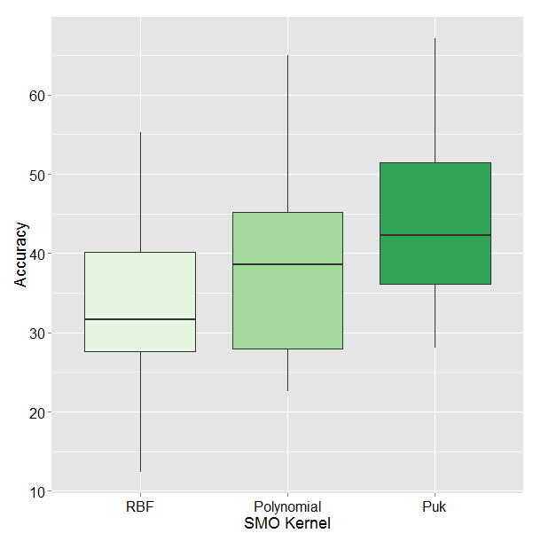
Accuracies of SVM
Friedman test
p-value = 4.63e-09
Nemenyi post-test
Puk and Polynomial
p-value = 0.0011
Puk and RBF
p-value = 2e-09
SVM Kernel
Notes:
In a preliminary experiment, we evaluate the kernels of the Support Vector Machine classifier input parameter.
This figure shows the boxplots of the accuracy values in each kernel. Using the Friedman test, the null hypothesis was rejected, indicating that there is a statistical difference between the results of the experiment.
Using the Nemenyi post-test, we could observe that Puk kernel was statistically better than Polynomial and RBF kernels.

Slide 13
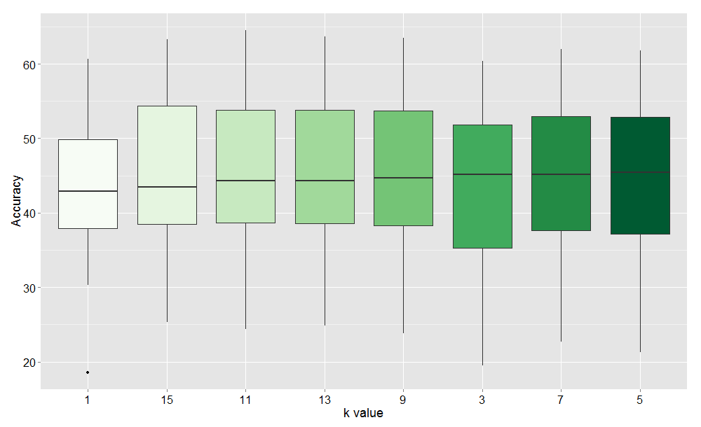
Accuracies of k-NN
Friedman test
p-value = 0.0175
Nemenyi post-test
No difference
Notes:
We also evaluate the k input parameter of the k-Nearest Neighbors classifier.
This Figure shows the boxplots of the accuracy values for the k variations, sorted by the median values.
In the Friedman test, the statistical difference was also accepted.
However, Nemenyi post-test showed no statistical difference among the top variations. So, the variation with k = 5 was chosen as it obtained the most number of victories among the variations.

Slide 14
Accuracies obtained for each project (Continuous Attributes)
Project | Core Team | MC (%) | Accuracy (%)
 |  |  | NB | J48 | RF | k-NN | SVM
akka | 7 | 35.89 | 11.21 | 59.35 | 68.27 | 61.00 | 56.87
angular | 15 | 33.68 | 8.86 | 34.20 | 40.21 | 36.58 | 42.90
Baystation12 | 14 | 22.84 | 7.91 | 40.40 | 44.12 | 44.92 | 42.26
bitcoin | 7 | 36.04 | 25.85 | 50.31 | 53.90 | 52.83 | 52.20
brackets | 27 | 18.25 | 5.43 | 30.24 | 34.72 | 31.77 | 30.16
commcare-hq | 11 | 40.36 | 14.87 | 50.37 | 52.43 | 51.34 | 51.46
gaia | 107 | 22.59 | 9.69 | 43.87 | 45.93 | 45.41 | 34.53
infinispan | 14 | 24.28 | 9.37 | 34.37 | 39.20 | 37.76 | 33.58
ipython | 11 | 29.90 | 8.49 | 45.79 | 48.98 | 49.32 | 48.05
katello | 20 | 12.43 | 10.03 | 34.31 | 35.69 | 36.03 | 31.02
kuma | 6 | 43.66 | 19.43 | 59.47 | 61.74 | 61.31 | 56.72
metasploit | 22 | 40.27 | 5.09 | 49.55 | 52.62 | 48.51 | 51.34
pandas | 10 | 42.69 | 17.96 | 63.37 | 67.44 | 61.80 | 67.12
phobos | 21 | 31.71 | 4.31 | 33.58 | 39.58 | 37.21 | 36.14
puppet | 45 | 20.44 | 4.68 | 35.87 | 41.95 | 35.74 | 33.07
rails | 29 | 22.96 | 16.34 | 18.03 | 22.45 | 21.25 | 27.27
rosdistro | 8 | 28.16 | 13.57 | 45.82 | 50.32 | 47.02 | 39.59
scala | 10 | 33.50 | 10.77 | 56.09 | 60.14 | 57.39 | 51.15
-tg-station | 9 | 37.86 | 4.56 | 39.09 | 44.22 | 43.36 | 40.71
titanium_mobile | 26 | 18.03 | 12.51 | 57.89 | 60.71 | 57.60 | 46.00
xbmc | 41 | 24.93 | 11.57 | 36.40 | 39.44 | 37.79 | 33.70
Average | 21,90 | 29.55 | 11.07 | 43.73 | 47.81 | 45.52 | 43.14
103%
Friedman test
p-value = 2.63e-13
187%
Nemenyi post-test
RF and SVM
p-value = 0.0006
RF and J48
p-value = 0.0003
RF and NB
p-value = 1.6e-13
RF and k-NN
No difference
236%
Notes:
This table shows in the core team column the amount of developers that analyzed pull requests in each project
The MC column represents the majority class, in other words, the highest percentage of pull requests analyzed by a single developer.
The other columns shows the accuracies of the classifiers: Naive Bayes, J48, Random Forest, k-NN and SVM.
At first, accuracies of the projects gaia 45%, katello 35%, and titanium mobile 60%, may seem low.
However, the Random Forest was able to improve the majority class percentage by 103% in gaia, 187% in katello, and 236% in titanium mobile.
For this experiment, the statistical difference was accepted once again in the Friedman test.
In the Nemenyi post-test, the Random Forest obtained statistically better results compared to SVM (Puk), J48 and NB. However, we could not observe statistical difference between Random Forest and k-NN (k=5).

Slide 15
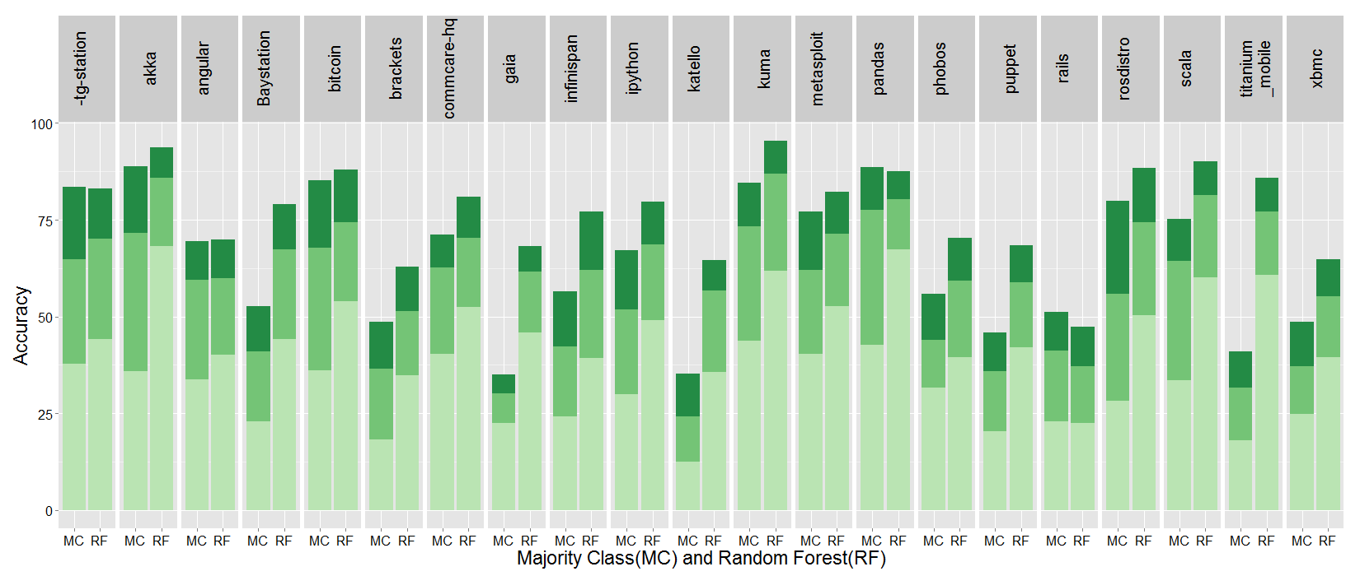
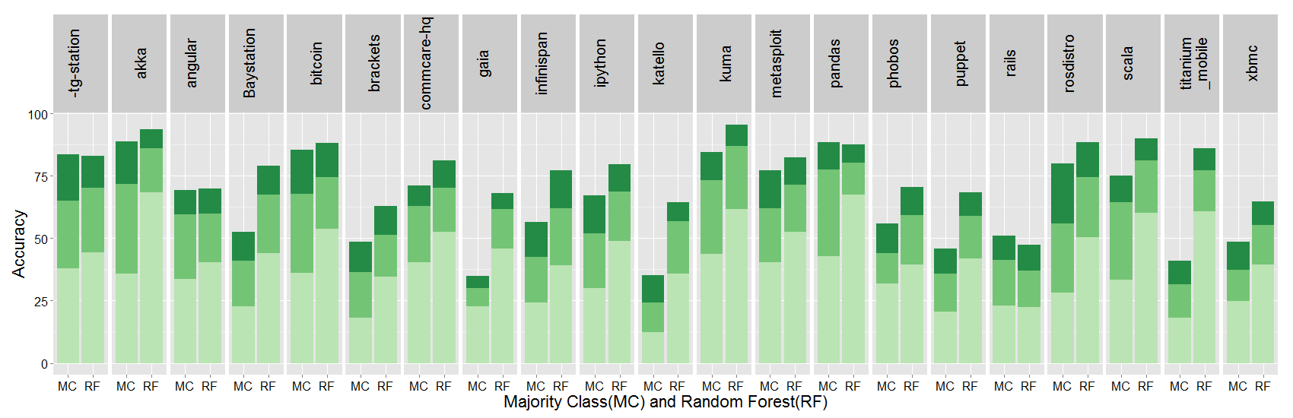
Ranking for developers assignment
Notes:
We recognized that sometimes the recommendation of a single developer might not work, as the recommended developer may be unavailable for some reason.
Aiming at mitigating this problem, we also evaluated the accuracy in the recommending a ranking of three developers.
This figure shows the percentage of the three majority classes (MC bars). So, each color tone represents the first, second and third developer who analyzed the most pull requests in each project.
RF bars shows the percentage of success for the first three recommendations made by the Random Forest classifier. So, each color tone represents the percentage of accuracy provided by each recommendation when the developer that actually analyzed the pull request had been recommended.
We can observe the results into following groups:
i) Projects that failed to present good results when considering the three Majority Classes.
ii) Projects in which the ranking reveals a promising strategy, significantly improving the success rate in the indication of three developers.

Slide 16
Agenda
Introduction
Materials and methods
Methodology
Projects
Attributes
Results and discussion
Accuracies of the classification algorithms
Developer’s ranking
Conclusions
Notes:
Finally, I am going to discuss about the conclusions.

Slide 17
Conclusions
The best accuracy in 76% of the projects – Random Forest
The accuracy for developer assignment was significantly increased in the ranking
The ranking approach did not produce good results for few projects
Future work
New predictive attributes (e.g. source code metrics)
Attribute Selection
Improve Accuracies
Notes:
The best accuracy in 76% of the projects was the Random Forest classifier using datasets with continuous attributes.
The accuracy for developer assignment was significantly increased in the ranking
The ranking approach did not produce good results for few projects
Finally, in future work we intend to investigate new predictive attributes, such as source code metrics.
The use of attribute selection strategies might improve the accuracies of our approach.

Slide 18
Developers Assignment for Analyzing Pull Requests
Manoel Limeira de Lima Júnior limeira@ufac.br
Daricélio Soares – UFAC/Brazil
Alexandre Plastino – UFF/Brazil
Leonardo Murta – UFF/Brazil
Notes:
‘

Slide 19
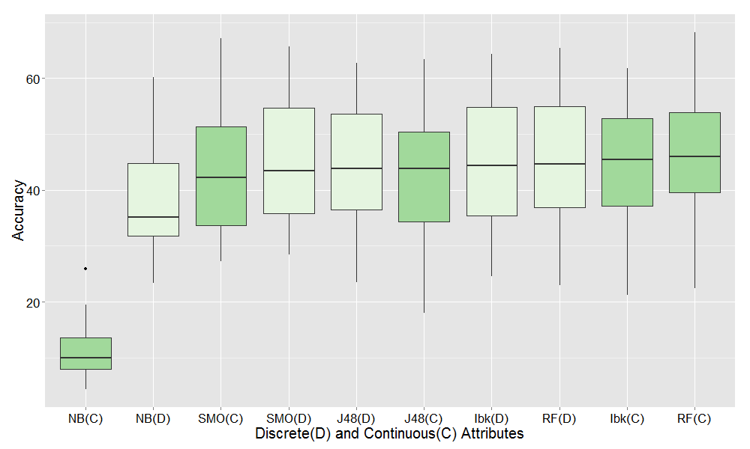
Accuracies with continuous and discrete attributes
Friedman test
p-value = 2.2e-16
Nemenyi post-test
No difference

